Slide 1


Unsupervised Learning using K-means Clustering: Python Vs ArcGIS
Cristian Noriega Monsalve, Blessing Austin-Gabriel, Ernest Chianumba, Rolih Ferdinand

Slide 2
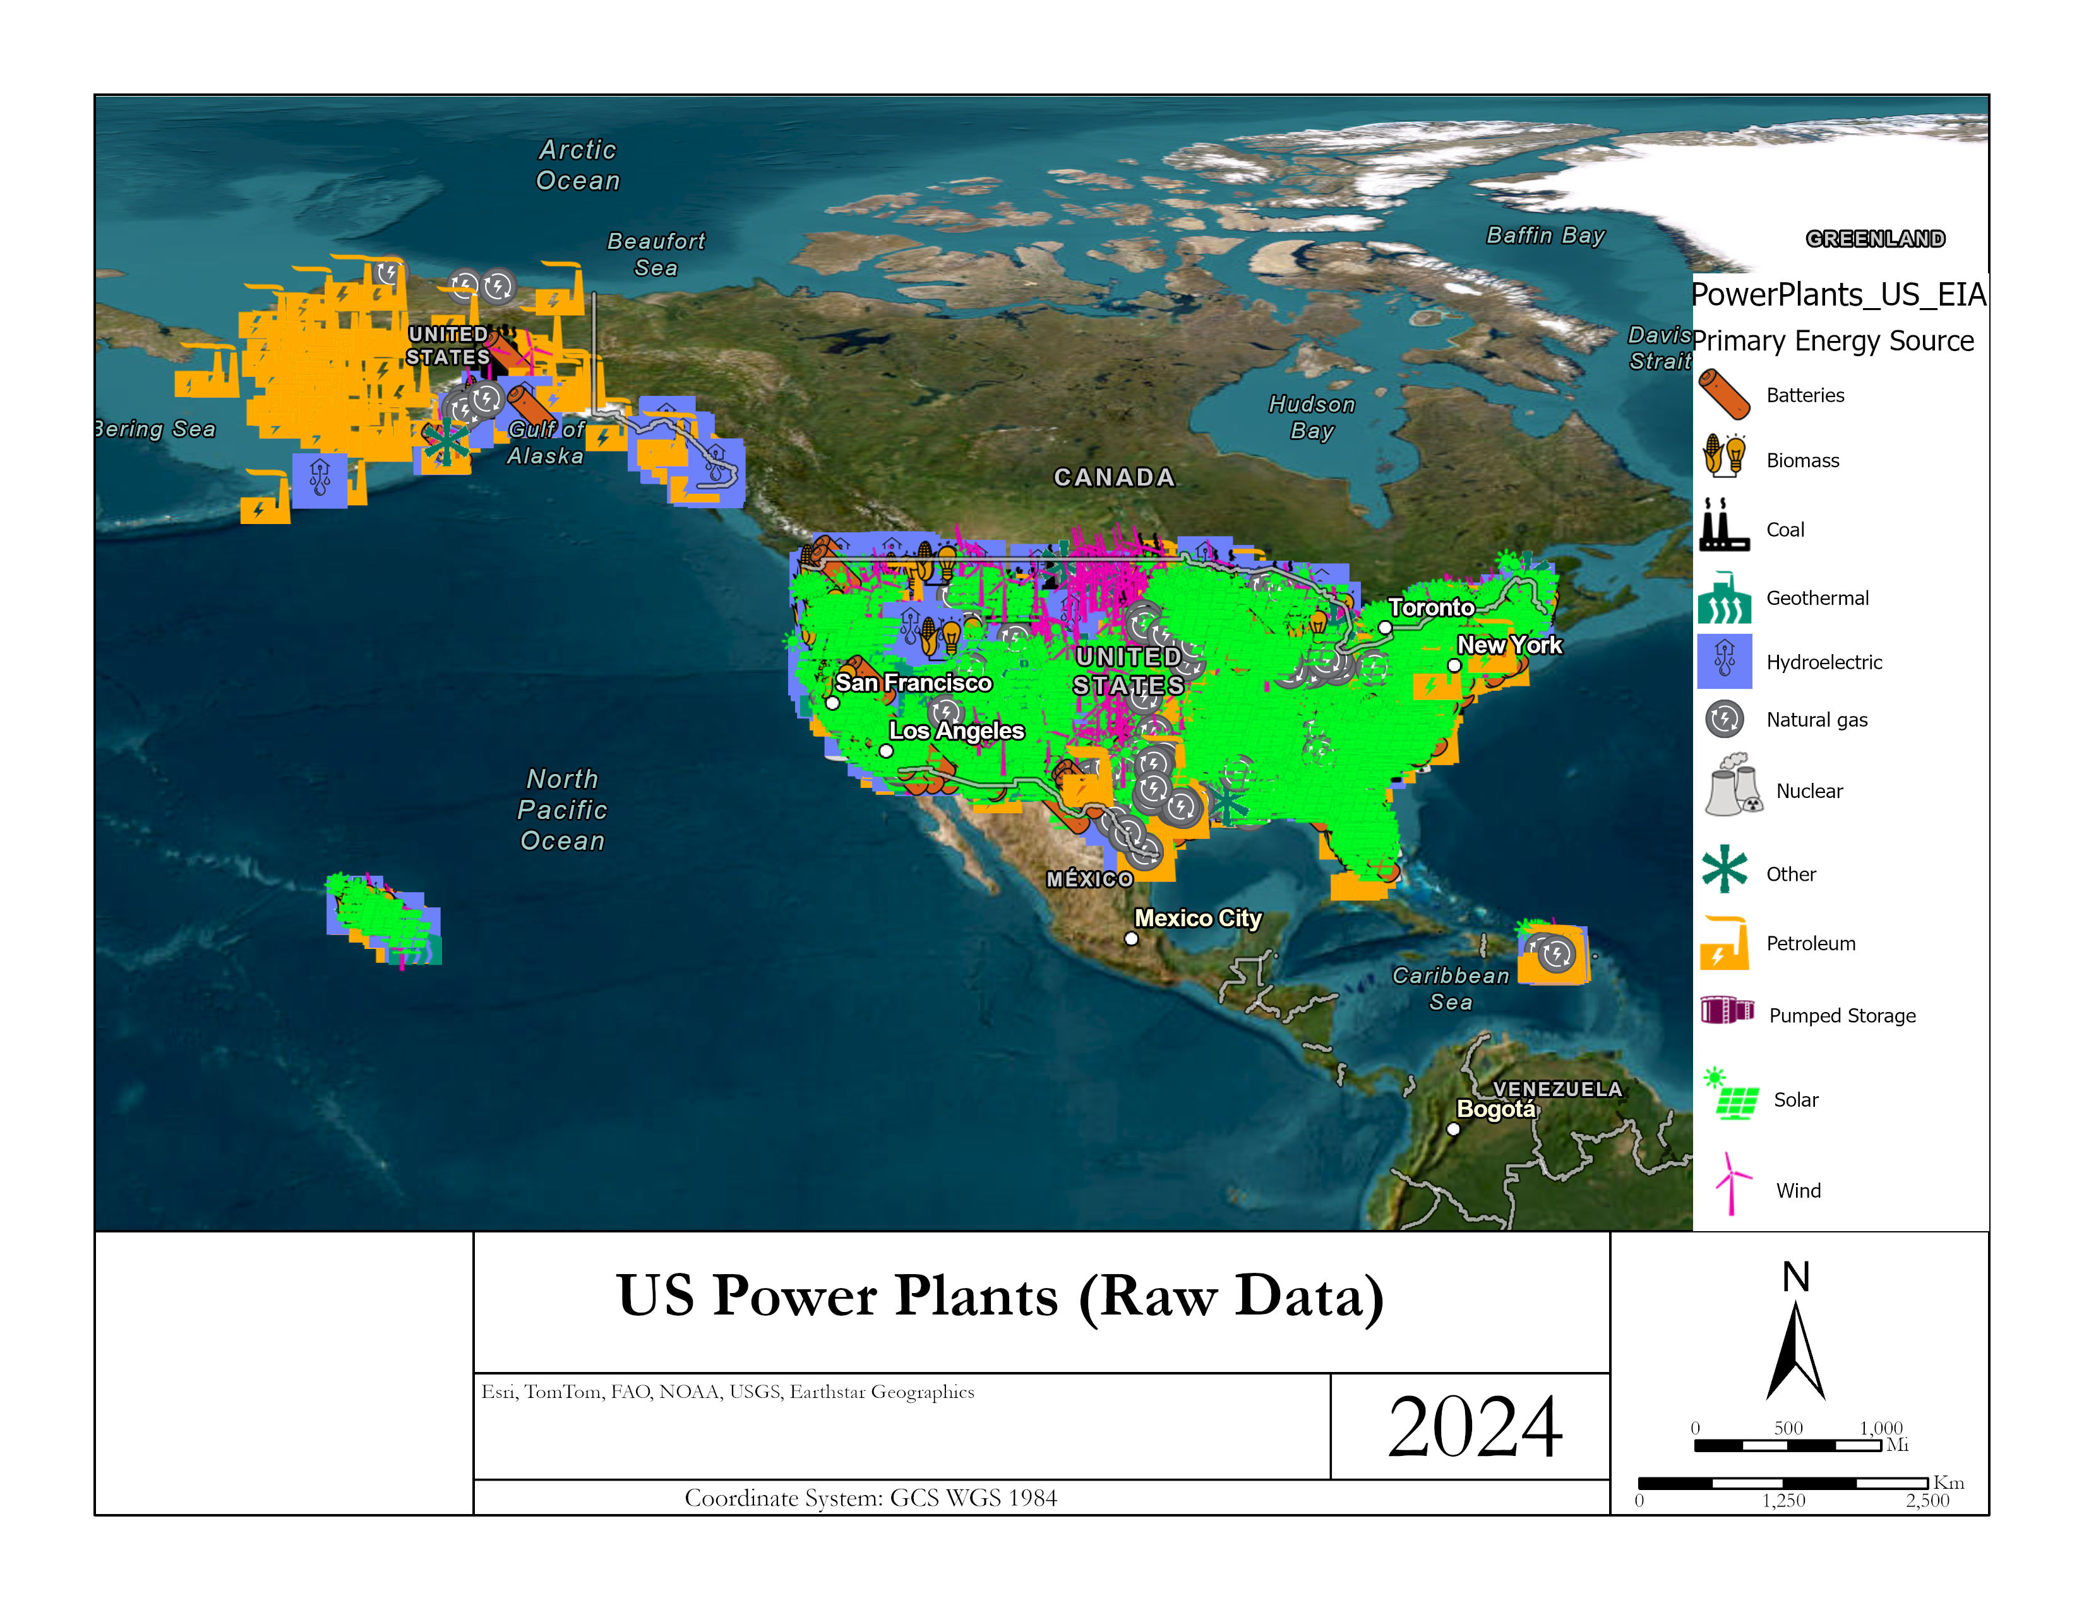
Data Set Visualization

Slide 3
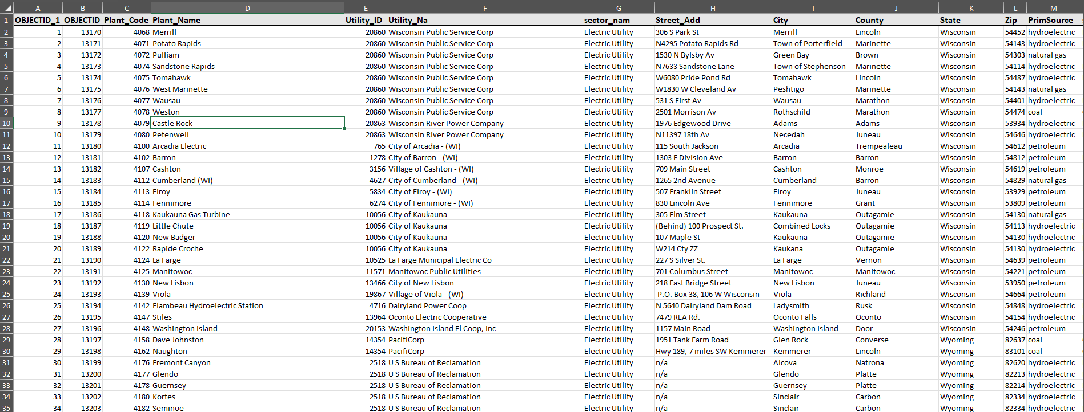
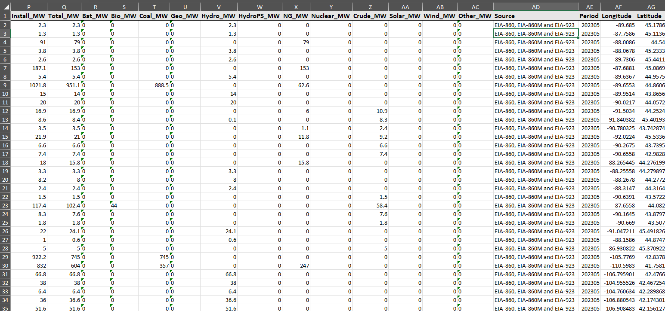
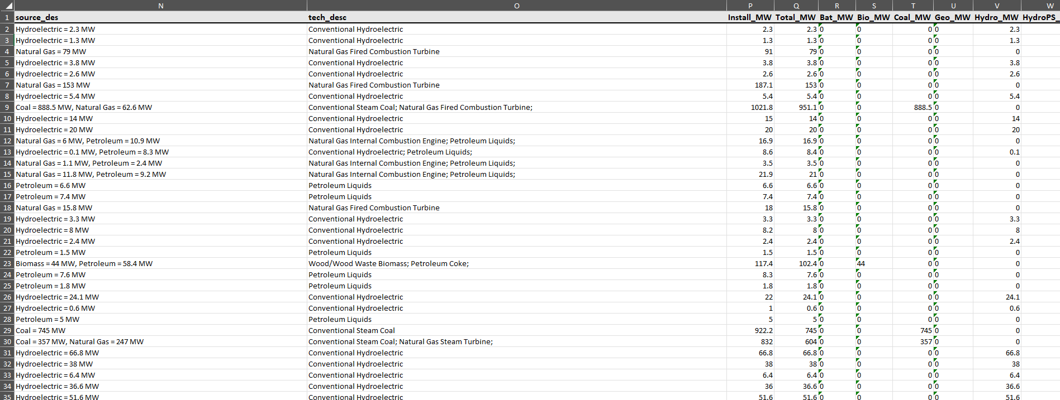
Data Set Description

Slide 4
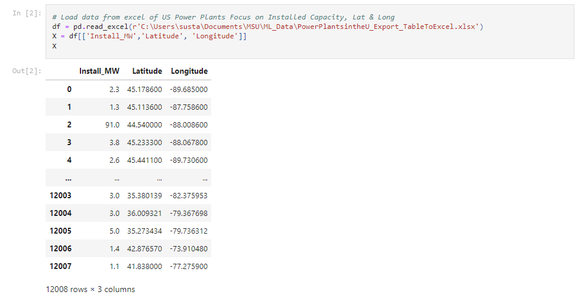
Preprocessing Techniques

Slide 5
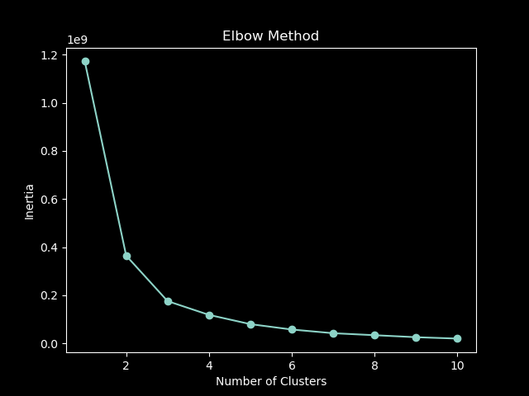
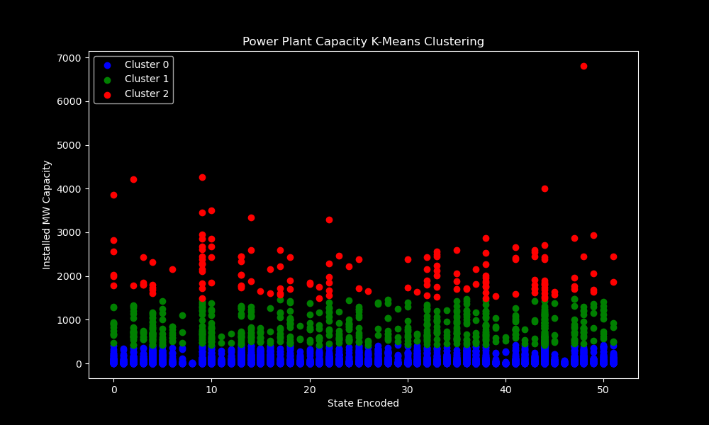
Machine Learning Technique: K-means Clustering

Slide 6
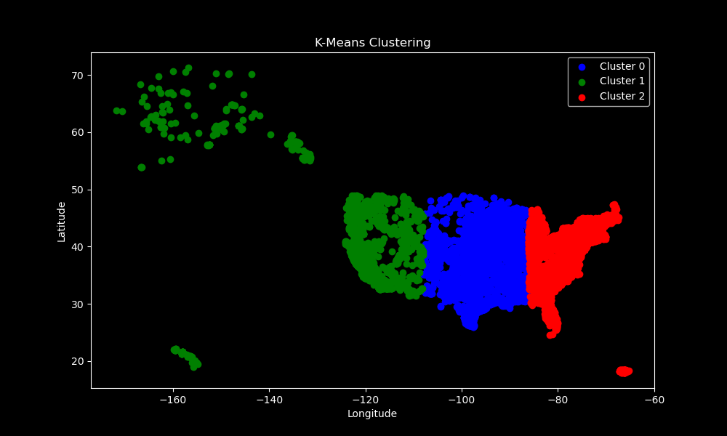
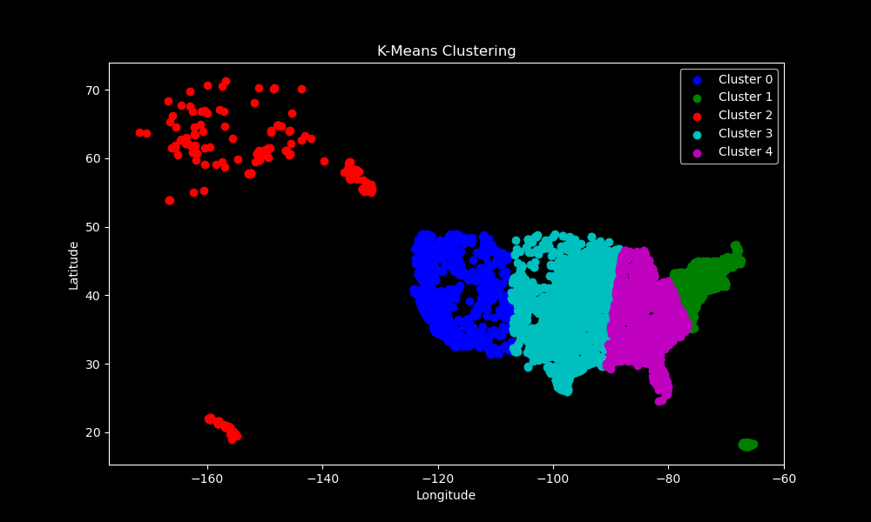
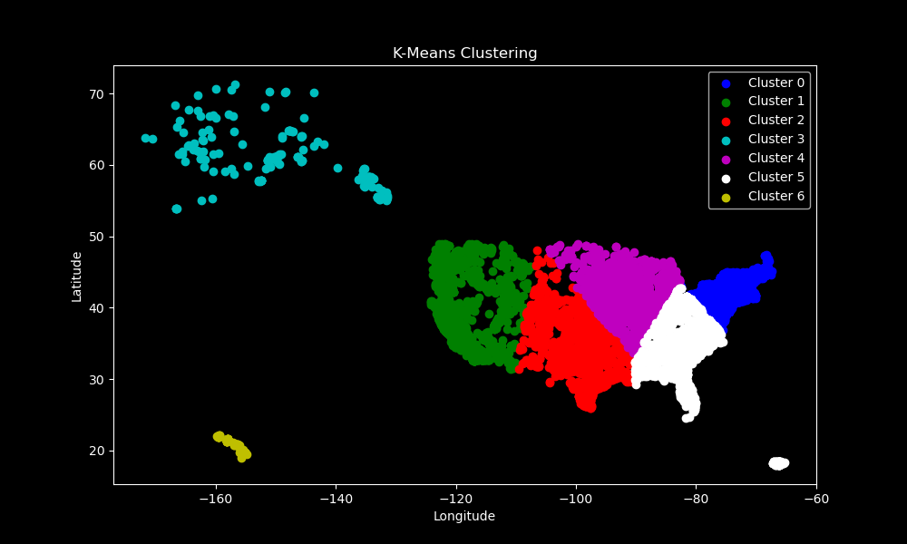
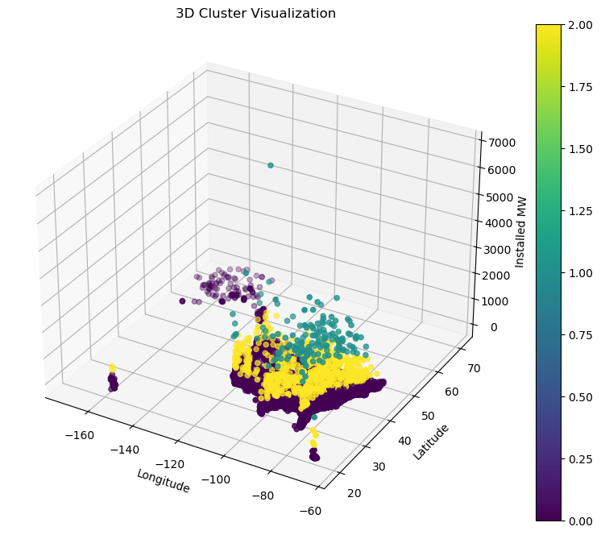
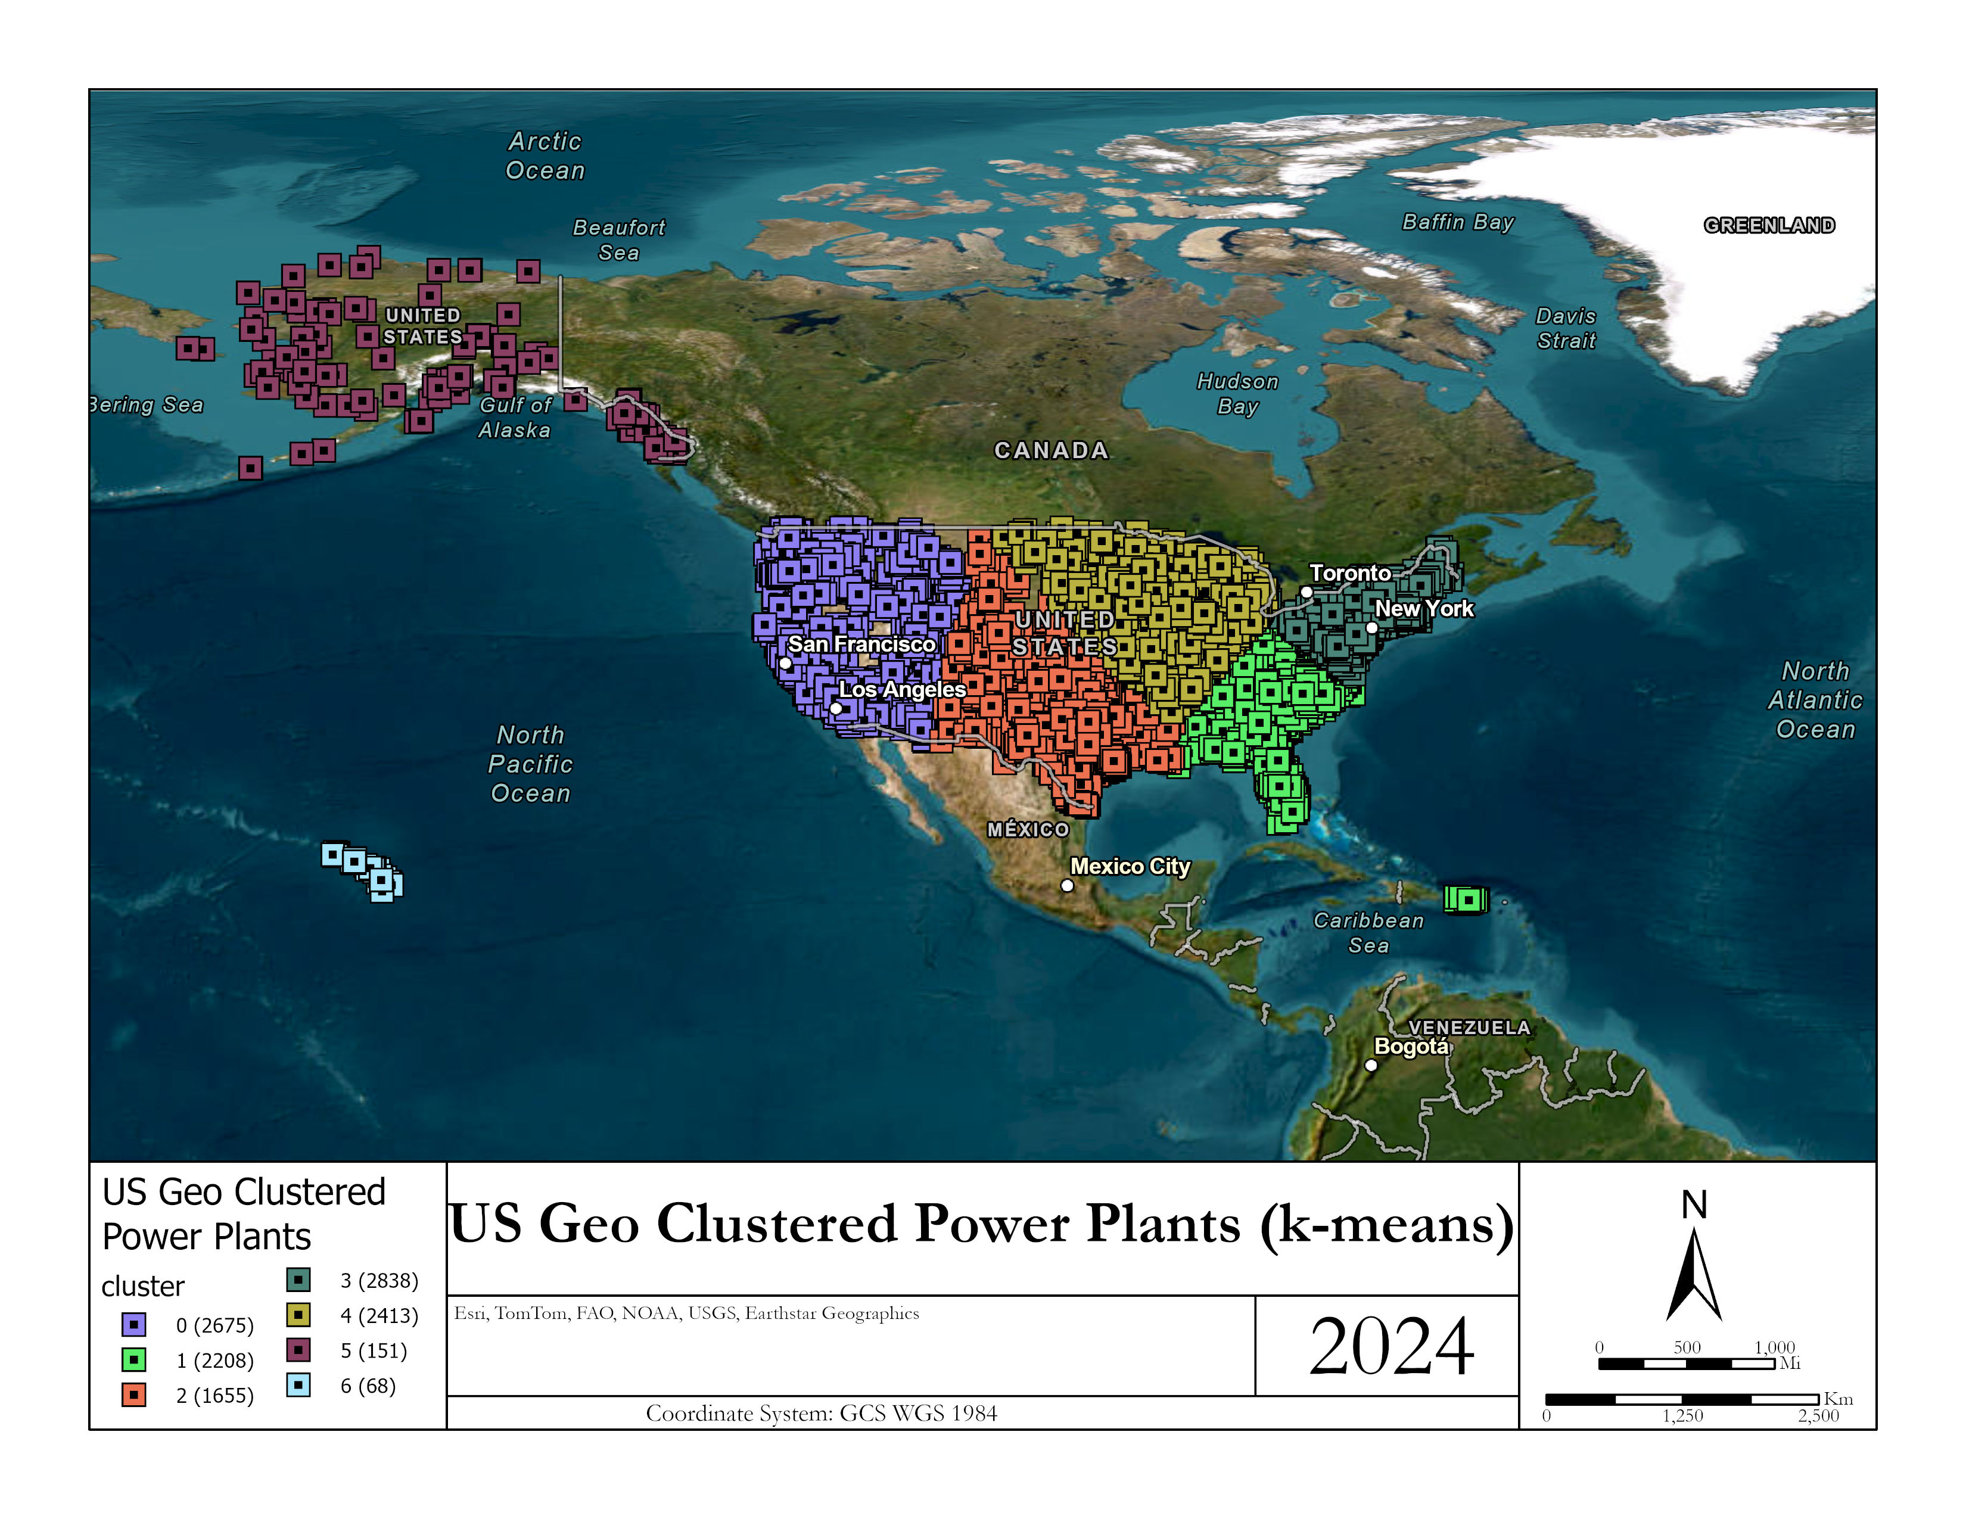
Python Results

Slide 7
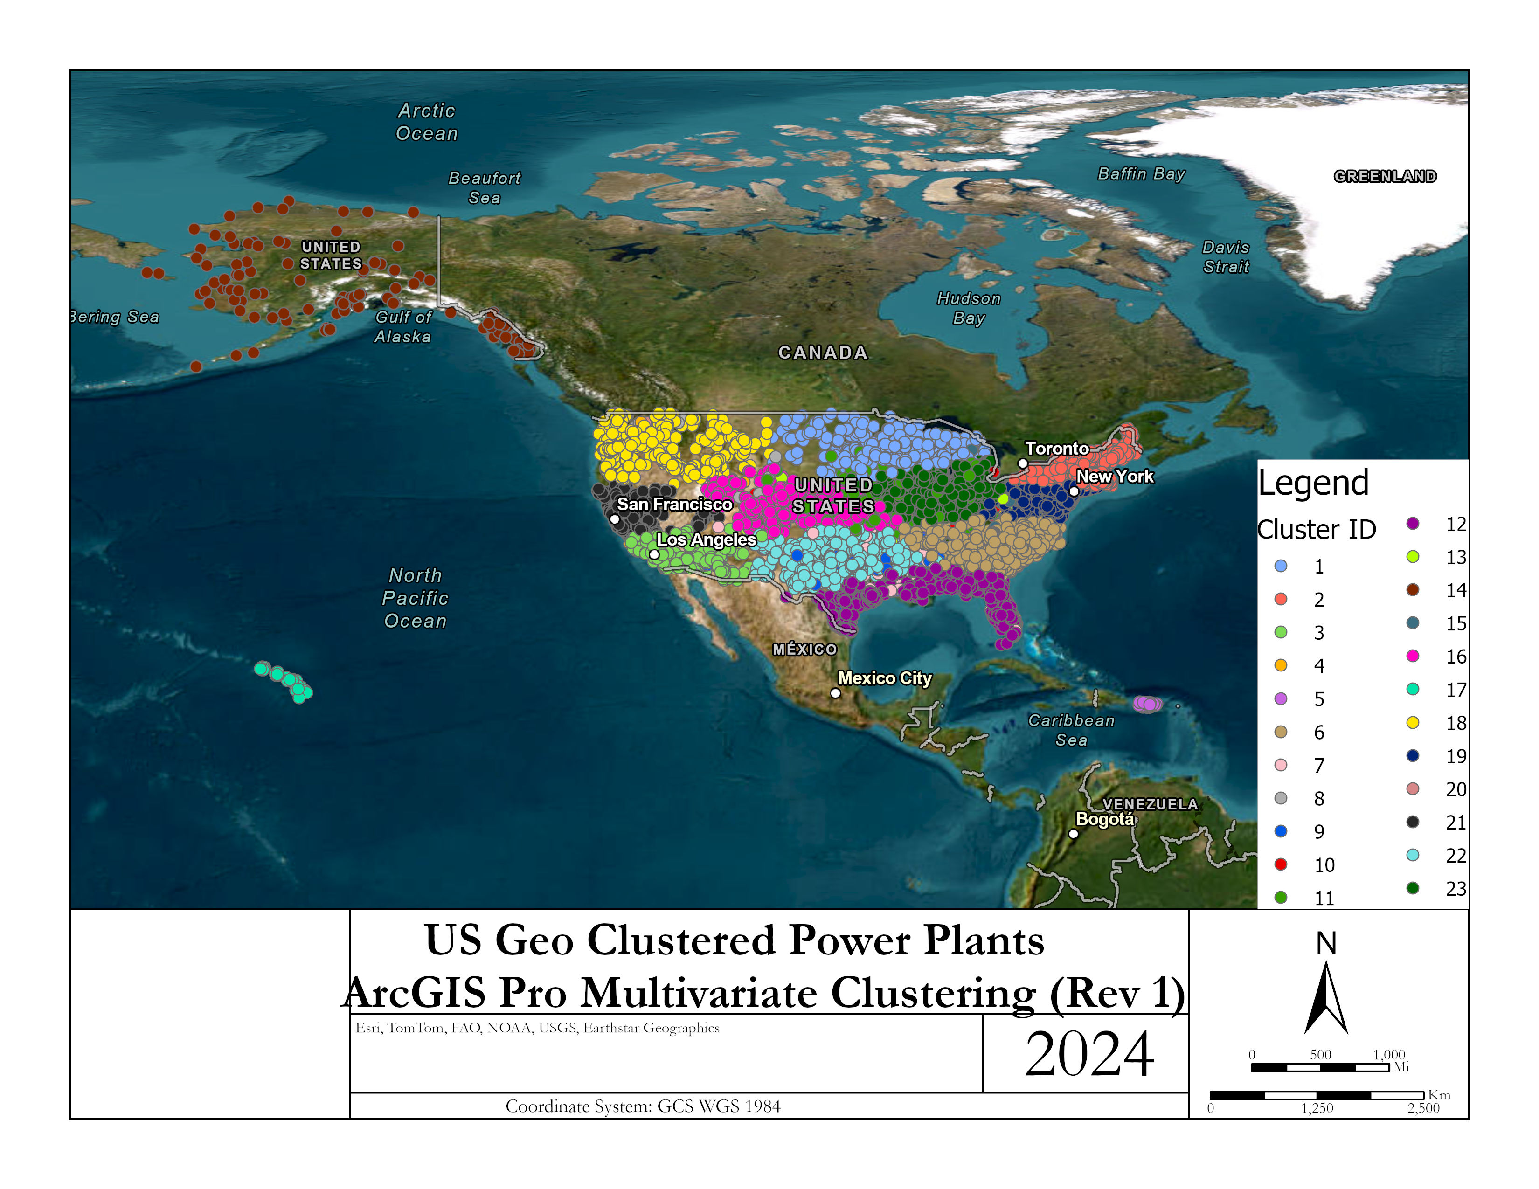
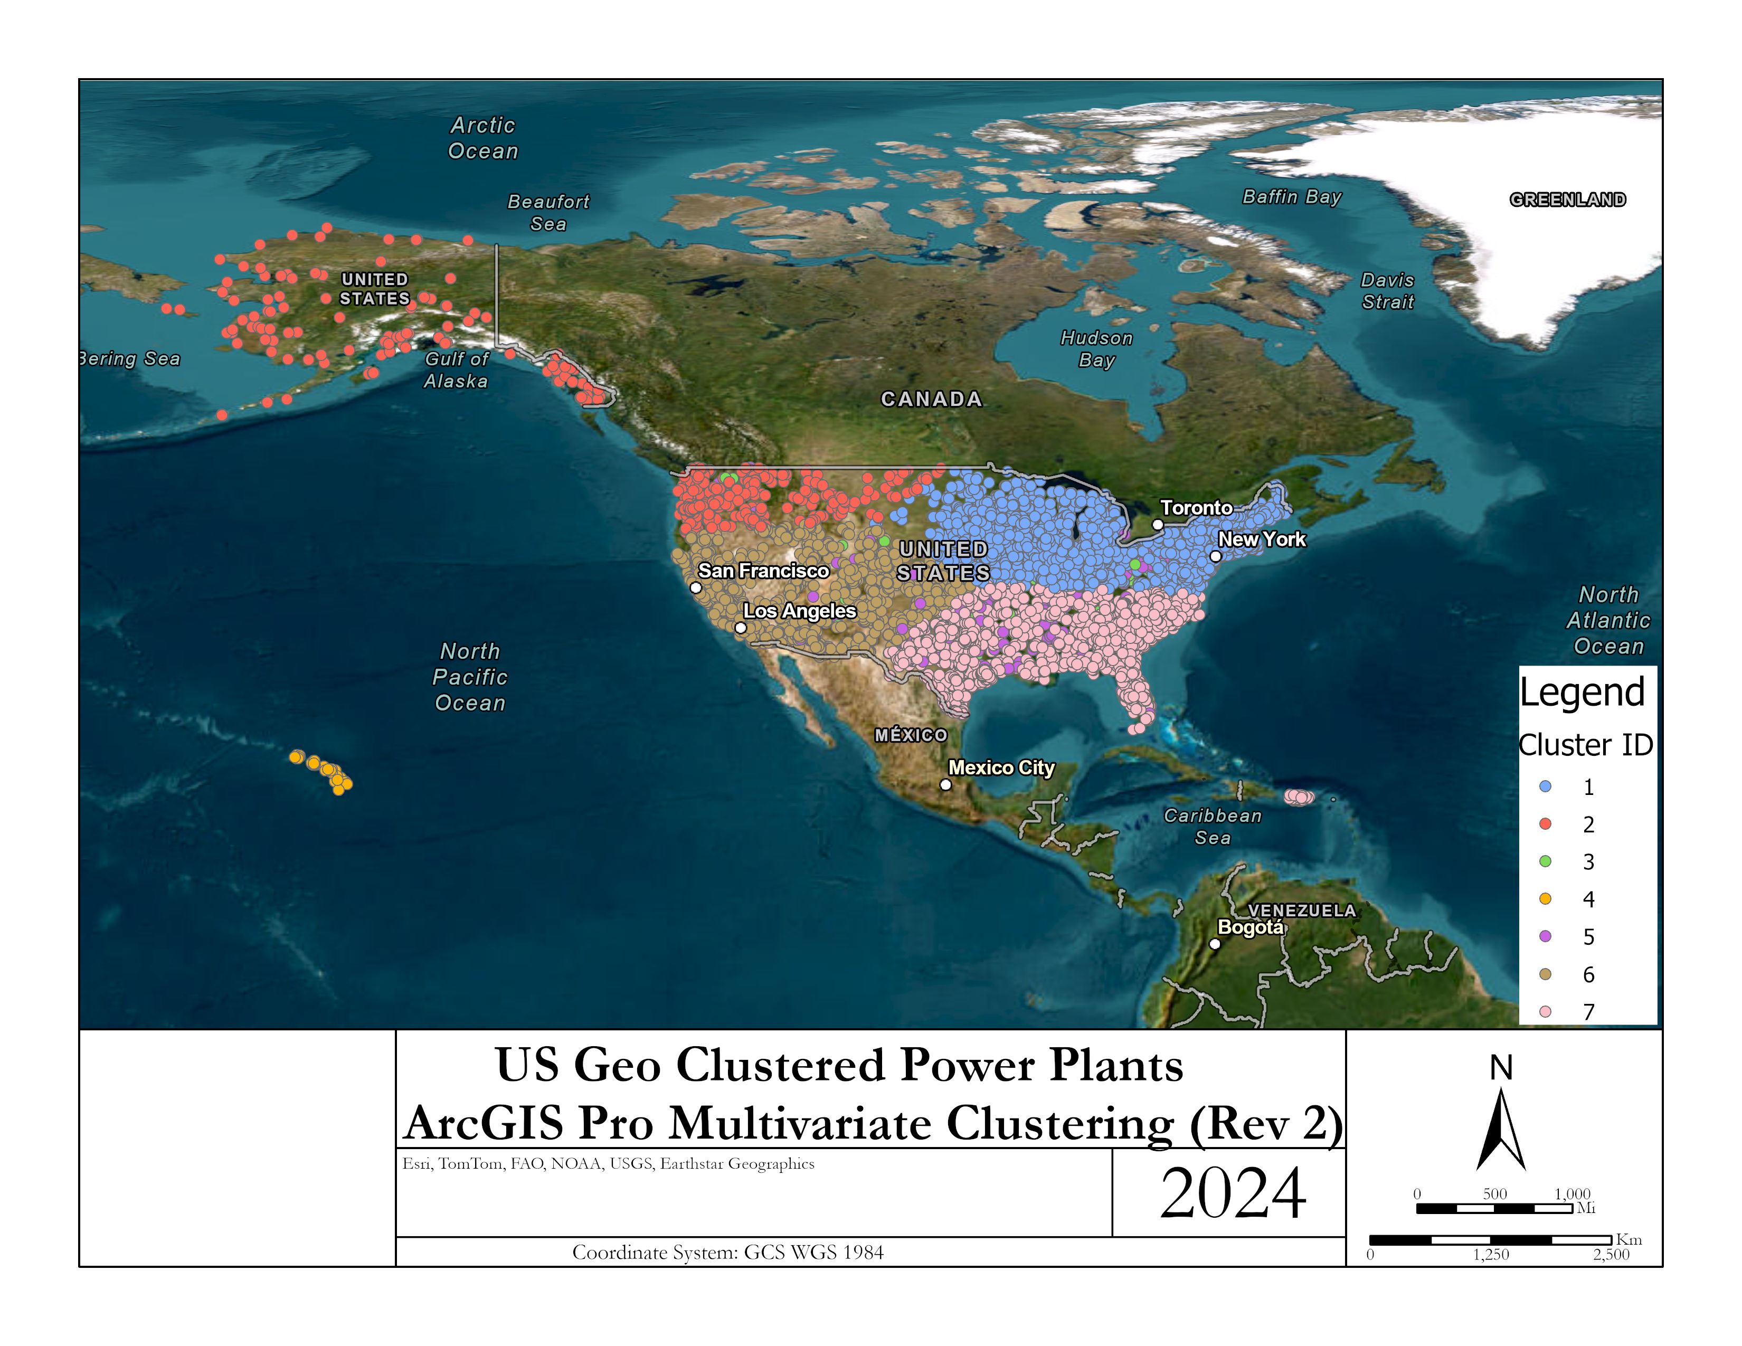
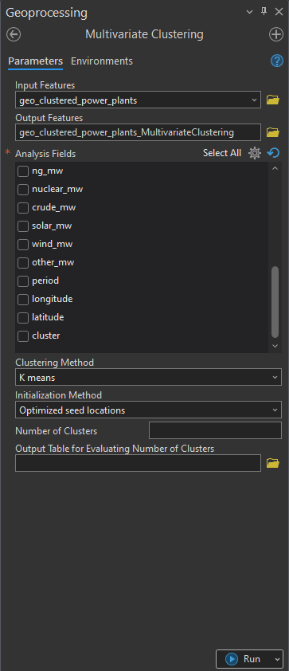
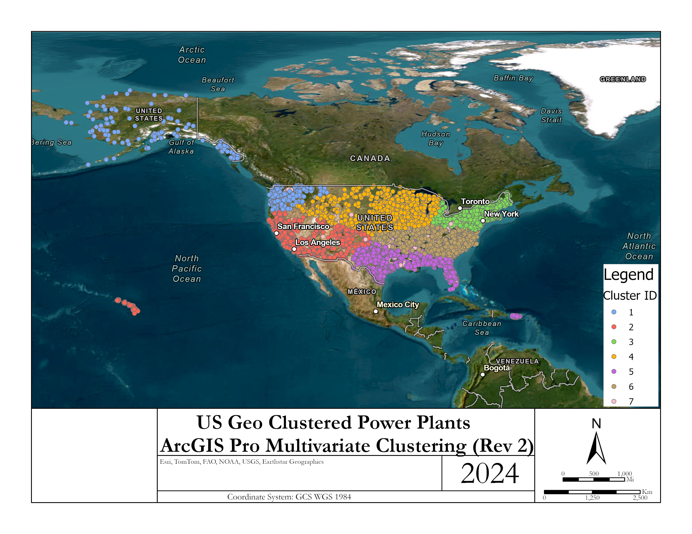
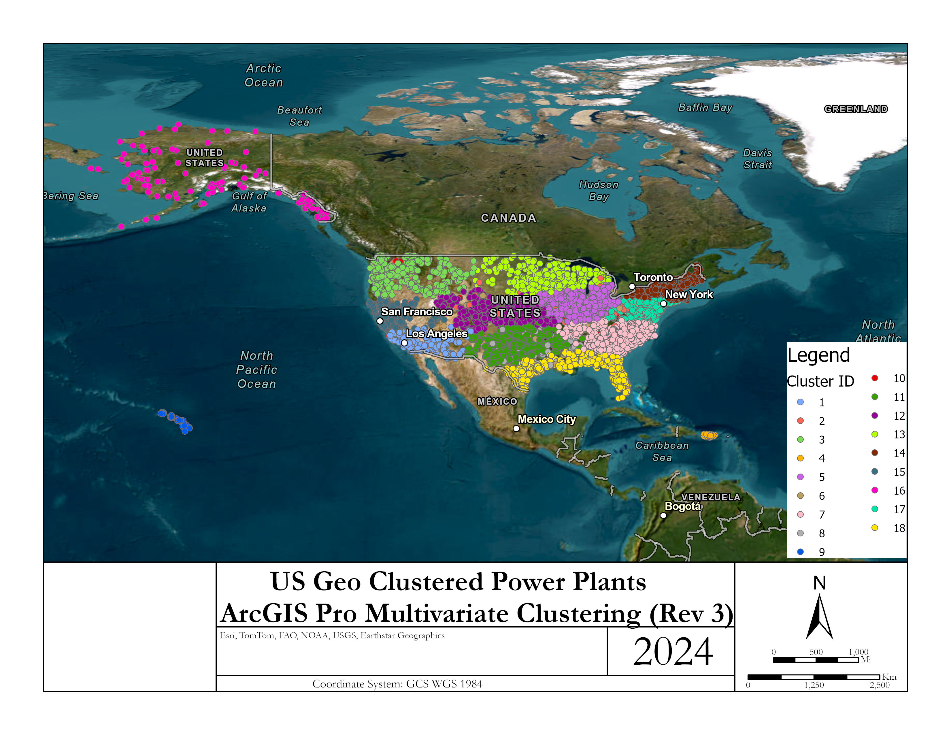
ArcGIS Results

Slide 8
Cluster Analysis Conclusion
We learned that different types of preprocessing can be utilized to perform a variety of further analysis especially depending on the type and variety of data that is collected.
Using power plants gives a wide range of initial attributes.
Once K values are determined even if using the optimum value (i.e. 3) doesn’t translate to accurate clusters. So we played around with different values until we got a proper fit. The best fit from my perspective came with the value of k=7.
ArcGIS Pro has a tool called Multivariate Clustering that we were able to use and compare to our python results and performs other combination of attributes to see how ArcGIS would perform its own clustering.

Slide 9
References
https://montclair.maps.arcgis.com/home/item.html?id=b063316fac7345dba4bae96eaa813b2f (US Power Plants Data source)
https://pro.arcgis.com/en/pro-app/latest/tool-reference/spatial-statistics/multivariate-clustering.htm (ArcGIS - Multivariate Clustering Tool)

